Slide 1
HEURISTIC SEARCH TECHNIQUES

Slide 2
Many traditional search algorithms are used in AI applications.
For complex problems, the traditional algorithms are unable to find the solutions within some practical time and space limits.
Consequently, many special techniques are developed, using heuristic functions(a function that ranks alternatives in search algorithms at each branching step based on available information to decide which branch to follow)
The algorithms that use heuristic functions are called heuristic algorithms.

Slide 3
Heuristic search
Heuristic search: To find a solution in proper time rather than a complete solution in unlimited time we use heuristics.
‘A heuristic function is a function that maps from problem state descriptions to measures of desirability, usually represented as numbers’.
Heuristic search methods use knowledge about the problem domain and choose promising operators first.
These heuristic search methods use heuristic functions to evaluate the next state towards the goal state.

Slide 4
Characteristics of heuristic search
• Heuristics are knowledge about domain, which help search and reasoning in its domain.
• Heuristic search incorporates domain knowledge to improve efficiency over blind search.
• Heuristic is a function that, when applied to a state, returns value as estimated merit of state, with respect to goal.
Heuristics might (for reasons) underestimate or overestimate the merit of a state with respect to goal.
Heuristics that underestimate are desirable and called admissible.
• Heuristic evaluation function estimates likelihood of given state leading to goal state.
• Heuristic search function estimates cost from current state to goal, presuming function is efficient.

Slide 5
Heuristic algorithms
Heuristic algorithms are not really intelligent; they appear to be intelligent because they achieve better performance.
Heuristic algorithms are more efficient because they take advantage of feedback from the data to direct the search path.

Slide 6
Hierarchical Representation of Search Algorithms: A Hierarchical representation of most search algorithms is illustrated below.
The representation begins with two types of search:
Uninformed Search: Also called blind, exhaustive or brute-force search, it uses no information about the problem to guide the search and therefore may not be very efficient.
Informed Search: Also called heuristic or intelligent search, this uses information about the problem to guide the search—usually guesses the distance to a goal state and is therefore efficient, but the search may not be always possible

Slide 7
Following are the various types of uninformed search algorithms:
Breadth-first Search
Depth-first Search
Depth-limited Search
Iterative deepening depth-first search
Uniform cost search
Bidirectional Search

Slide 8
Following are the various types of informed search algorithms:
1)Pure Heuristic
2)A * tree search
3)Greedy Algorithm or Best Search
4)A * Graph Search

Slide 9
Some prominent intelligent search algorithms
are stated below:
1. Generate and Test Search
2. Hill Climbing
3.Best-first Search
4. A* Search

Slide 10
Generate and Test Strategy
Generate-And-Test Algorithm
Generate-and-test search algorithm is a very simple algorithm that guarantees to find a solution if done systematically and there exists a solution.

Slide 11
Algorithm
1.Generate a possible solution.
2.Test to see if this is the expected solution.
3.If the solution has been found quit else go to step 1.
Potential solutions that need to be generated vary depending on the kinds of problems. For some problems the possible solutions may be particular points in the problem space and for some problems, paths from the start state.

Slide 12
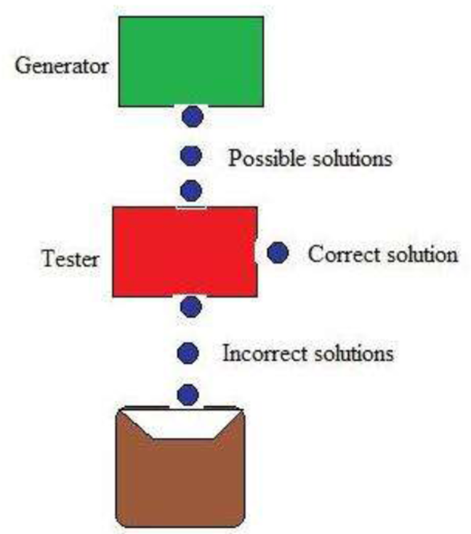

Slide 13
Depth-first search tree with backtracking can be used to implement systematic generate-and-test procedure.
Exhaustive generate-and-test is very useful for simple problems. But for complex problems even heuristic generate-and-test is not very effective technique
AI program DENDRAL

Slide 14
Hill Climbing
Hill Climbing is heuristic search used for mathematical optimization problems in the field of Artificial Intelligence .
Given a large set of inputs and a good heuristic function, it tries to find a sufficiently good solution to the problem.
Features of Hill Climbing
1. Variant of generate and test algorithm : It is a variant of generate and test algorithm.
The generate and test algorithm is as follows :
1. Generate a possible solutions.
2. Test to see if this is the expected solution.
3. If the solution has been found quit else go to step 1

Slide 15
Simple Hill climbing : It examines the neighboring nodes one by one and selects the first neighboring node which optimizes the current cost as next node.
Algorithm for Simple Hill climbing :
Step 1 : Evaluate the initial state. If it is a goal state then stop and return success. Otherwise, make initial state as current state.
Step 2 : Loop until the solution state is found or there are no new operators present which can be applied to current state.
Select a state that has not been yet applied to the current state and apply it to produce a new state.
Perform these to evaluate new state i.e If the current state is a goal state, then stop and return success. ii. If it is better than the current state, then make it current state and proceed further. iii. If it is not better than the current state, then continue in the loop until a solution is found.
Step 3 : Exit.

Slide 16
Steepest-Ascent Hill climbing : It first examines all the neighboring nodes and then selects the node closest to the solution state as next node.
Step 1 : Evaluate the initial state. If it is goal state then exit else make the current state as initial state
Step 2 : Repeat these steps until a solution is found or current state does not change
i. Let ‘target’ be a state such that any successor of the current state will be better than it;
ii. for each operator that applies to the current state a. apply the new operator and create a new state b. evaluate the new state c. if this state is goal state then quit else compare with ‘target’ d. if this state is better than ‘target’, set this state as ‘target’ e. if target is better than current state set current state to Target
Step 3 : Exit

Slide 17
Different regions in the State Space Diagram
1. Local maximum : It is a state which is better than its neighboring state however there exists a state which is better than it(global maximum). This state is better because here value of objective function is higher than its neighbors.
2. Global maximum : It is the best possible state in the state space diagram. This because at this state, objective function has highest value.
3. Plateau/flat local maximum : It is a flat region of state space where neighboring states have the same value.
4. Ridge : It is region which is higher than its neighbors but itself has a slope. It is a special kind of local maximum.
5. Current state : The region of state space diagram where we are currently present during the search.
6. Shoulder : It is a plateau that has an uphill edge.

Slide 18
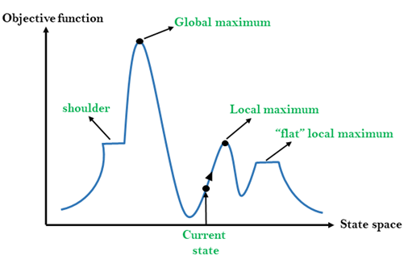

Slide 19
Best First Search
Heuristic search algorithm that selects the most promising node for expansion based on evaluation function.
Aims to efficiently navigate toward the goal state making it particularly effective for optimization problems.

Slide 20
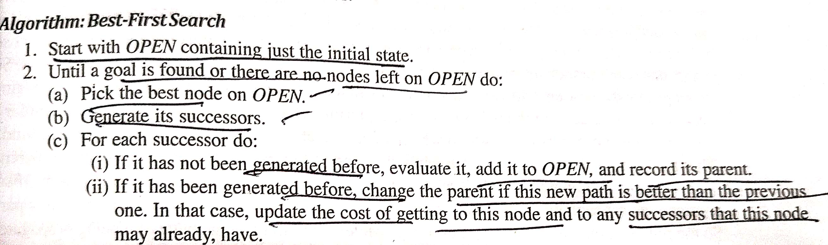
Algorithm

Slide 21
A* Algorithm
A* is a cornerstone name of many AI systems and has been used since it was developed in 1968 by Peter Hart; Nils Nilsson and Bertram Raphael.
A* search finds the shortest path through a search space to goal state using heuristic function.
This technique finds minimal cost solutions and is directed to a goal state called A* search

Slide 22
A* requires heuristic function to evaluate the cost of path that passes through the particular state. It can be defined by following formula.
f(n)=g(n)+h(n)
Where
g(n): The actual cost path from the start state to the current state.
h(n): The actual cost path from the current state to goal state.
f(n): The actual cost path from the start state to the goal state.

Slide 23
For the implementation of A* algorithm we will use two arrays namely OPEN and CLOSE.
OPEN: An array which contains the nodes that has been generated but has not been yet examined.
CLOSE: An array which contains the nodes that have been examined

Slide 24
Advantages
It is complete and optimal.
It is the best one from other techniques.
It is used to solve very complex problems.
It is optimally efficient, i.e. there is no other optimal algorithm guaranteed to expand fewer nodes than A*.

Slide 25
Disadvantages
This algorithm is complete if the branching factor is finite and every action has fixed cost.
The speed execution of A* search is highly dependant on the accuracy of the heuristic algorithm that is used to compute h (n).
It has complexity problems

Slide 26
PROBLEM REDUCTION
When a problem can be divided into a set of sub problems, where each sub problem can be solved separately and a combination of these will be a solution, AND-OR graphs or AND - OR trees are used for representing the solution.
The decomposition of the problem or problem reduction generates AND arcs. One AND are may point to any number of successor nodes.
All these must be solved so that the arc will rise to many arcs, indicating several possible solutions. Hence the graph is known as AND - OR instead of AND

Slide 27
ALGORITHM
1. Initialize the graph to the starting node.
2. Loop until the starting node is labelled SOLVED or until its cost goes
above FUTILITY:
(i) Traverse the graph, starting at the initial node and following the current best path
and accumulate the set of nodes that are on that path and have not yet been
expanded.
(ii) Pick one of these unexpanded nodes and expand it. If there are no successors,
assign FUTILITY as the value of this node. Otherwise, add its successors to the
graph and for each of them compute f'(n). If f'(n) of any node is O, mark that node as
SOLVED.
(iii) Change the f'(n) estimate of the newly expanded node to reflect the new
information provided by its successors. Propagate this change backwards through
the graph. If any node contains a successor arc whose descendants are all solved,
label the node itself as SOLVED

Slide 28
AND-OR GRAPH
An AND/OR graph is a graph which represents a problem solving process.
A solution graph is a subgraph of the AND/OR graph which represents a derivation for a solution of the problem.
Therefore, solving a problem can be viewed as searching for a solution graph in an AND/OR graph. A “cost” is associated with every solution graph.
A minimal solution graph in a solution graph with minimal cost. In this paper, an algorithm for searching for a minimal solution graph in an AND/OR graph is described.
If the “lower bound” condition is satisfied, the algorithm is guaranteed to find a minimal solution graph when one exists

Slide 29
The AND-OR GRAPH (or tree) is useful for representing the solution of problems that can solved by decomposing them into a set of smaller problems, all of which must then be solved.
This decomposition, or reduction, generates arcs that we call AND arcs. One AND arc may point to any number of successor nodes, all of which must be solved in order for the arc to point to a solution.
Just as in an OR graph, several arcs may emerge from a single node, indicating a variety of ways in which the original problem might be solved.
This is why the structure is called not simply an AND-graph but rather an AND-OR graph (which also happens to be an AND-OR tree)

Slide 30
AO * ALGORITHM
1. Let G consists only to the node representing the initial state call this node INTT. Compute h' (INIT).
2. Until INIT is labeled SOLVED or hi (INIT) becomes greater than FUTILITY, repeat the following procedure.
Trace the marked arcs from INIT and select an unbounded node NODE.
(II) Generate the successors of NODE . if there are no successors then assign FUTILITY as h' (NODE). This means that NODE is not solvable. If there are successors then for each one called SUCCESSOR, that is not also an ancester of NODE do the following
(a) add SUCCESSOR to graph G
(b) if successor is not a terminal node, mark it solved and assign zero to its h ' value.
(c) If successor is not a terminal node, compute it h' value.

Slide 31
(III) propagate the newly discovered information up the graph by doing the following . let S be a set of nodes that have been marked SOLVED. Initialize S to NODE. Until S is empty repeat the following procedure;
select a node from S call if CURRENT and remove it from S.
compute h' of each of the arcs emerging from CURRENT , Assign minimum h' to CURRENT.
Mark the minimum cost path a s the best out of CURRENT.
Mark CURRENT SOLVED if all of the nodes connected to it through the new marked are have been labeled SOLVED.
If CURRENT has been marked SOLVED or its h ' has just changed, its new status must be propagate backwards up the graph . So add all of the ancestors of CURRENT are added to S.

Slide 32
What is the difference between A* Algorithm and
AO* algorithm? A* algorithm provides with the optimal solution, whereas AO* stops when it finds any solution.
AO* algorithm requires lesser memory compared to A* algorithm.
AO* algorithm doesn't go into infinite loop whereas the A* algorithm can go into an infinite loop.

